Slide 1
Object-Oriented Programming Concepts

Slide 2
Today’s Presentation
➢ What is an Object?
➢ What is a Class?
➢ What is a Message?
➢ Requirements of Object-Oriented language
➢ Step by step explanation

Slide 3
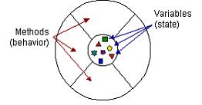
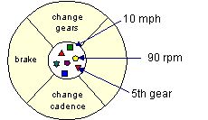
What is an Object?
An object is a software bundle of related variables and methods. Software objects are often used to model real-world objects you find in everyday life.
Visual representation of a software object A bicycle modeled as a software object

Slide 4
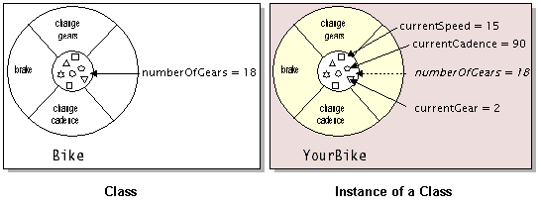
What is a Class?
A class is a blueprint or prototype that defines the variables and the methods common to all objects of a certain kind.
➢ Class is an implementation of an abstract data type and so encapsulates both data and operations.
➢ Object is run-time instance of class.
Classes just sit there, objects do the real work.
Memory is allocated for Objects not for Classes.

Slide 5
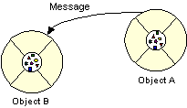
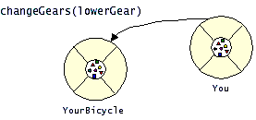
What is a Message?
Software objects interact and communicate with each other using messages.
➢ The object to which the message is addressed (YourBicycle)
➢ The name of the method to perform (changeGears)
➢ Any parameters needed by the method (lowerGear)

Slide 6
To be object oriented, a language must support
➢ Encapsulation
➢ Inheritance
➢ Dynamic Binding
Some of the popular OO languages are
C++
Smalltalk
Java
Eiffel
FORTRAN90
CLOS(Common Lisp Object System)
Ada95
Modula-3

Slide 7

Encapsulation:
Packaging an object's variables within the protective custody of its methods is called encapsulation.
Often, for practical reasons, an object may wish to expose some of its variables or hide some of its methods.
Access Levels:
Specifier | Class | Subclass | Package | World
Private | X
Protected | X | X | X
Public | X | X | X | X

Slide 8
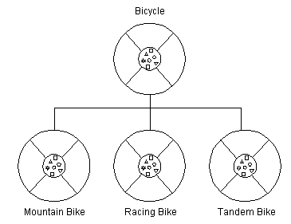
What is Inheritance?
A class inherits state and behavior from its superclass. Inheritance provides a powerful and natural mechanism for organizing and structuring software programs.
Super Class
Subclasses

Slide 9
Properties:
➢Each subclass inherits state (in the form of variable declarations) from the superclass.
Subclasses can add variables and methods to the ones they inherit from the superclass.
Subclasses can also override inherited methods and provide specialized implementations for those methods.
You are not limited to just one layer of inheritance. The inheritance tree, or class hierarchy, can be as deep as needed.
Benefits:
⇨Re-Usability
Subclasses provide specialized behaviors from the basis of common elements provided by the superclass. Through the use of inheritance, programmers can reuse the code in the superclass many times.
⇨Can define Abstract Classes
Programmers can implement superclasses called abstract classes that define "generic" behaviors.

Slide 10
A
B
Types of Inheritance:
Multi-level Inheritance
Multiple Inheritance
A
C
B
A-1
B-1
C
A-2
B-2
Multiple Multi-level Inheritance
AB

Slide 11
Dynamic Binding:
➢ Dynamic binding occurs when the type of variable changes at run-time.
A common way for a variable to change its type is via assignment.
Bike:= MoutainBike is safe
MountainBike:=Bike is not safe
MountainBike is declared to have all the features of Bike so the assignment does no harm.
➢ A variable that starts life of the type Bike may be attached to any object that is a kind of Bike, including MountainBike,RacingBike,…
➢ A variable that starts life of the type MountainBike can only be attached to MountainBike objects but does not include RacingBike or general Bike.

Slide 12
Polymorphism:
➢ The ability to appear in many forms.
➢ In object-oriented programming, polymorphism refers to a programming language's ability to process objects differently depending on their data type or class.
It is the ability to redefine methods for derived classes.
E.g. e-bike Acceleration system.
Electronically / Mechanically

